Slide 1

Terrawise
A comprehensive web platform that helps users track, measure, and improve their environmental impact through personalized recommendations and community engagement.

Slide 2

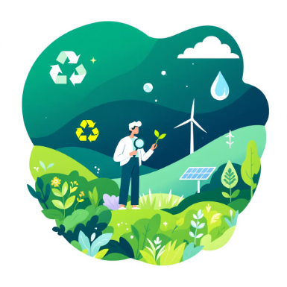
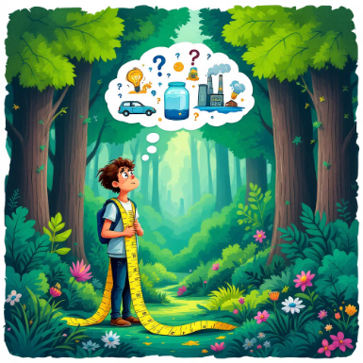
The Problem
An app that helps users make more sustainable lifestyle choices by providing personalized, context-aware recommendations and tracking their environmental impact.
Uncertain Users
Data Gaps
No Tracking
Don't know how to reduce their carbon footprint
Lack reliable information on sustainable choices
Can't measure their environmental impact

Slide 3
Objectives
Personalised lifestyle changes
Carbon Footprint Tracker
Provide personalized, context-aware sustainability tips.
Track and visualize users' carbon footprint anytime
User Retention
Seamless User Experience
Foster a community through gamification and shared eco-actions.
Integrate sustainability into users' daily routines.

Slide 4
Literature Review
The Sustainability app
Yindii app
TerraScore
Focuses on organisation sustainability and planning
Focuses on lifestyle changes via food sustainability
Tracks progress based on sustainable actions, closely based on a similar idea as Terrawise
Gap identification -
Gap identification -
Gap identification-
No focus on individuals, works only on large scale
Focus only on one aspect of sustainability, does not account other factors
No good user experience and no recommendation system
Klima app
Ecofy
Earth Hero
Calculates carbon footprint
Focuses on lifestyle tracking
Tracks progress based on sustainable actions
Gap identification -
Gap identification -
Gap identification -
Only shows stats, does not provide actionable measures
No recommendation system or actionable insights
No good user experience and no recommendation system

Slide 5
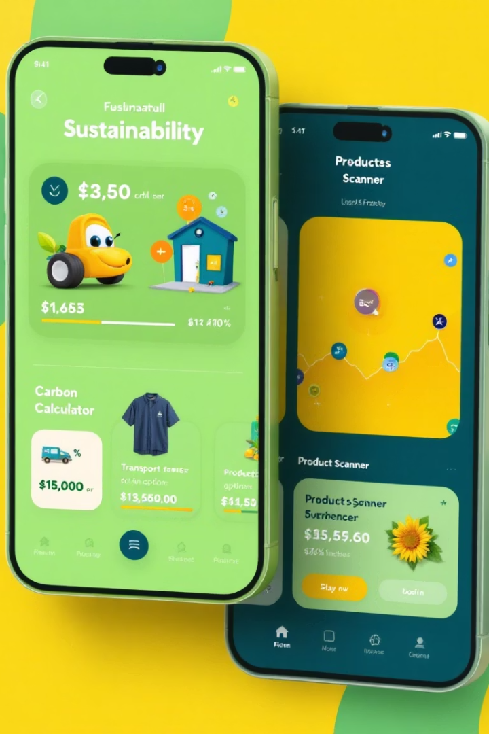




Core Features
Carbon Footprint Calculator
Tracks food, electricity, shopping, and transport emissions using Climatiq API.
Green Transport Navigator
Identifies nearby public transport using OpenStreetMap API with proximity alerts.
Recommendation system
Gives personalised recommendations and actionable insights for lifestyle changes
Gamification System
Rewards sustainable choices with badges and community challenges.

Slide 6
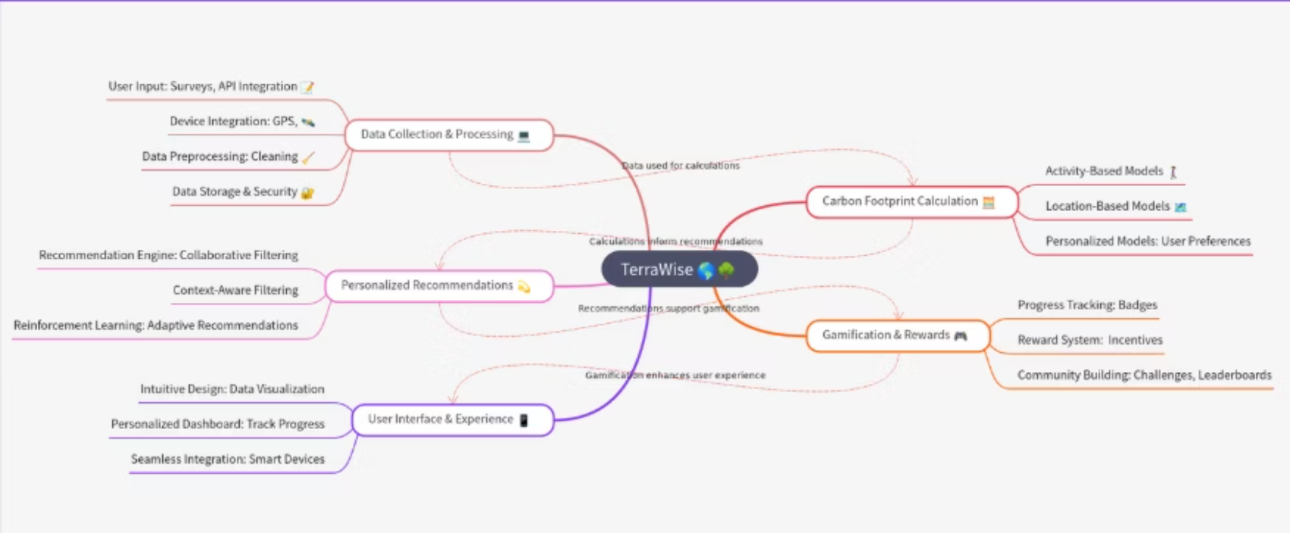
Mind Mapping

Slide 7
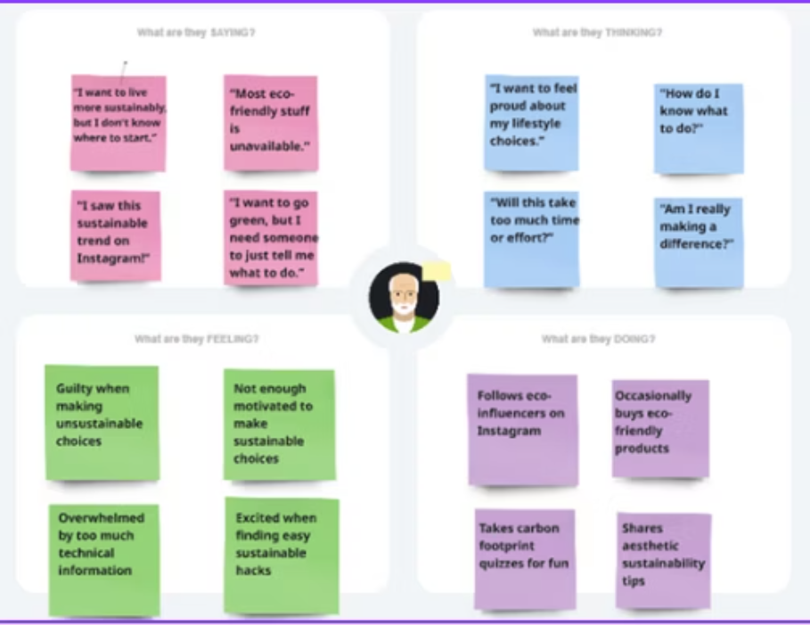
Empathy Mapping

Slide 8
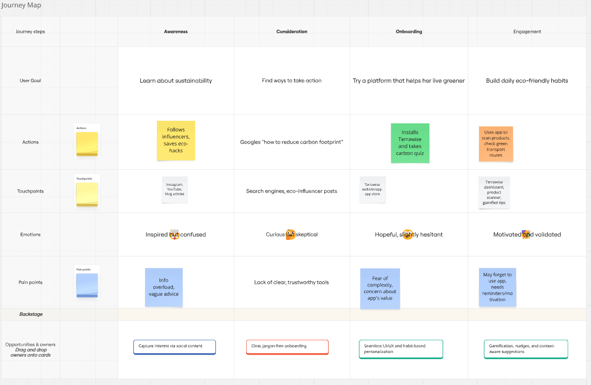
Journey Mapping

Slide 9
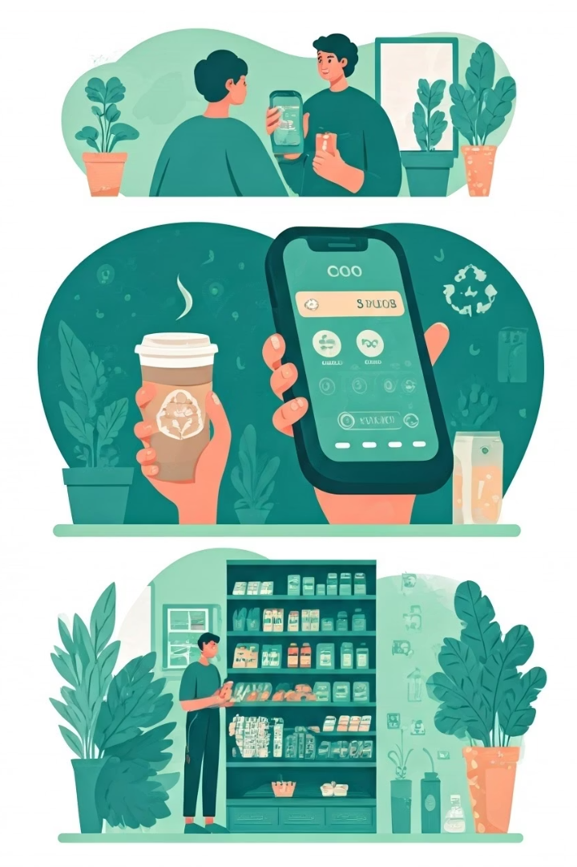




User Journey
Download & Setup
Alex creates a profile and completes the initial footprint assessment.
Daily Tracking
Monitors carbon emissions from transportation, food, and energy use.
Smart Shopping
Scans products to identify eco-friendly alternatives.
Measurable Impact
Sees tangible reduction in carbon footprint over time.

Slide 10
Story Board
Frame 1: Struggle
📍 Scene: Riya scrolling Instagram late at night
💭 Thought: “I want to be more eco-friendly, but it’s all too confusing.”
🗨️ Problem: Overwhelmed by scattered, vague sustainability advice.
Frame 2: Discovery
📍 Scene: Sees a Terrawise ad on Instagram with a quiz link
💭 Thought: “A personalized sustainability guide? That sounds useful.”
🗨️ Trigger: Signs up and takes the carbon footprint quiz.
Frame 3: Insightful Onboarding
📍 Scene: Terrawise dashboard showing her carbon score and lifestyle habits
💭 Thought: “Whoa, food and clothing are my biggest impact areas!”
🗨️ Value: Gets a clear breakdown of her environmental impact.
Frame 4: Personalized, Context-Aware Tips
📍 Scene: Sunday morning. Terrawise recommends DIY composting
💭 Thought: “Perfect timing! I was free and curious about composting anyway.”
🗨️ Magic: Context-aware advice that actually fits her schedule and mindset.

Slide 11
Story Board
Frame 5: Action + Empowerment
📍 Scene: Riya switches to a sustainable brand, shares her change on Instagram
💭 Thought: “I’m proud I did this—and my friends are inspired too!”
🗨️ Behavioral shift: Feels confident and socially validated.
Frame 6: Loyalty + Impact
📍 Scene: A week later, Riya checks her updated carbon footprint
💭 Thought: “My score improved! These small changes really add up.”
🗨️ Retention: Keeps using Terrawise for regular eco-habit suggestions.

Slide 12




User Interface Design
Dashboard
Transport Map
Personal carbon footprint overview and daily tips
Nearby green transport options with carbon savings
Community
Product Scanner
Challenges, badges, and shared achievements
Ingredient analysis with sustainability ratings

Slide 13
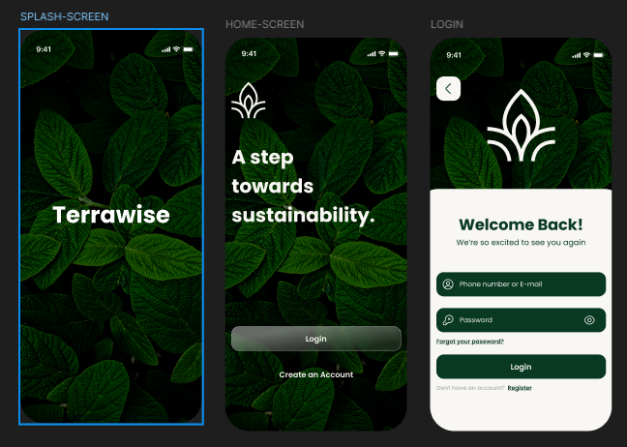

Slide 14
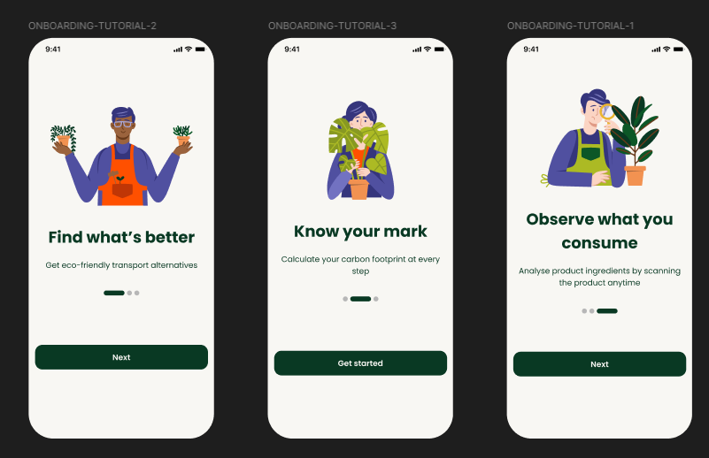

Slide 15
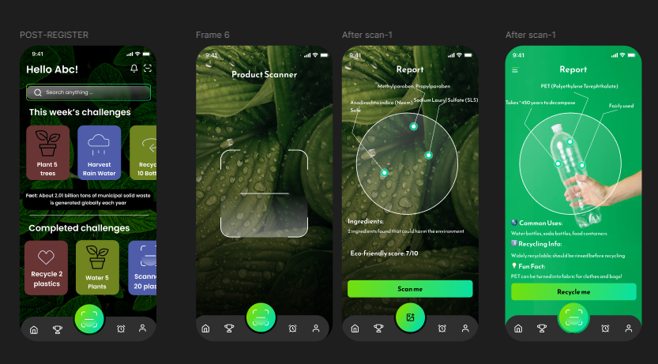

Slide 16
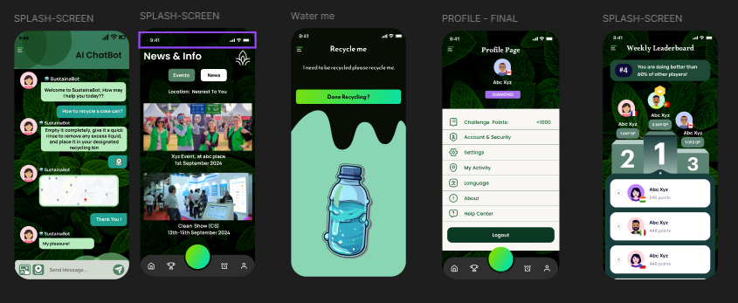

Slide 17
REFERENCES
carbon footprint calculato-co2.myclimate.org
https://ourworldindata.org/co2/country/india#
https://www.climatiq.io/
https://www.epa.gov/climateleadership/scope-1-and-scope-2-inventory-guidance
https://www.researchgate.net/publication/372493975_Carbon_footprint_research_paper
https://www.sciencedirect.com/science/article/abs/pii/S2352550918303944
https://www.emerald.com/insight/content/doi/10.1108/mscra-06-2020-0016/full/html
https://www.researchgate.net/publication/355843251_Sustainable_AI_Environmental_Implications_Challenges_and_Opportunities

